Slide 1
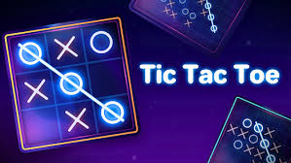
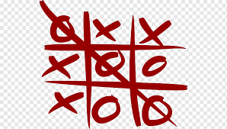
TIC TAC TOE
GUIDED BY
MISS HARAPRIYA SENAPATI
REPRESENTED BY
AMIT KUMAR SAMAL (230720100157)
JANMEJAY OJHA(230720100158)
DEBABRAT PATTANAIK(230720100126)
SUSHREE APARAJITA JENA(230720100176)
SWATI SMARANIKA CHOUDHURY(230720100140)

Slide 2
CONTEXT :
Introduction
Scope of the project
Breakdown of code
Final output in console
Conclusion
Future scope

Slide 3
Introduction
Greetings, everyone. Today, we embark on a concise exploration of the classic game, Tic-Tac-Toe. Beyond its surface simplicity, this presentation aims to unravel the strategic layers that make Tic-Tac-Toe more than just a childhood pastime. We'll delve into its history, mechanics, cultural impact, and strategic intricacies. From basic tactics to advanced maneuvers, we'll uncover the strategies that elevate Tic-Tac-Toe beyond mere chance. Additionally, we'll touch upon its role in artificial intelligence, shedding light on how this seemingly simple game has become a playground for testing advanced algorithms. Join us as we decode Tic-Tac-Toe, revealing its strategies and exploring its broader significance. Welcome to "Decoding Tic-Tac-Toe: Unveiling Strategies and Significance."

Slide 4
1. Core Functionality: Game functionality:
SCOPE OF THE PROJECT
Implement the standard Tic Tac Toe game rules.
Allow two players to take turns marking the board.
Recognize winning conditions (horizontal, vertical, diagonal) and declare a winner.
Detect ties when the board is full.
2. User Interface: Console-Based Interface:
Display the Tic Tac Toe board and player prompts in the console.
Implement input handling for players to make moves

Slide 5
3. Core Objectives in Tic Tac Toe: Player Turns:
Players take turns placing their symbols on an empty square on the board.
Winning Conditions:
The game is won when a player successfully creates a line of three of their symbols either horizontally, vertically, or diagonally.
Blocking Opponent:
Players strategically place their symbols to block their opponent from creating a winning line.
Game Termination:
The game ends when a player wins, or the entire board is filled without a winner, resulting in a tie.

Slide 6
Breakdown of Code
1. Initialization of the Board:
char box[10]: An array representing the Tic Tac Toe board. Indices 1 to 9 are used for the board, and each element is initialized with characters '0' through '9'.
2. Function Prototypes:
void Board_creating();: Function prototype for displaying the Tic Tac Toe board.
void Board_marking(int, char);: Function prototype for marking the board based on player input.
int Check_win();: Function prototype for checking if there is a winner.

Slide 7
3. Main Function ():
Variables: choice stores the player's move, player keeps track of the current player, and mark represents 'X' or 'O'.
A do-while loop runs the game until there is a winner or a tie.
The loop includes calls to Board_creating(), input from the current player, marking the board, and checking for a winner.
The loop ends when Check_win() returns a value other than -1.
4. Board_creating() Function:
Displays the Tic Tac Toe board with player markers.
5. Board_marking() Function:
Marks the board based on the player's choice, ensuring the move is valid.

Slide 8
6. Check_win() Function:
Checks for a winner or a tie by examining all possible winning combinations (horizontal, vertical, diagonal).
Returns 1 if there's a winner, 0 for a tie, and -1 if the game is still ongoing
7. Winning Conditions:
Horizontal, vertical, and diagonal matches are checked using if-else conditions.
If any of the conditions are met, the function returns 1, indicating a winner.
8. Tie Condition:
If none of the winning conditions are met, and all positions on the board are filled, the function returns 0, indicating a tie.

Slide 9
9. Invalid Move:
If the player tries to make a move in an already occupied position or an invalid position, "Invalid option" is printed.
10. End of the Game:
After the do-while loop, the final state of the board is displayed, and the result (winner or tie) is printed.

Slide 10
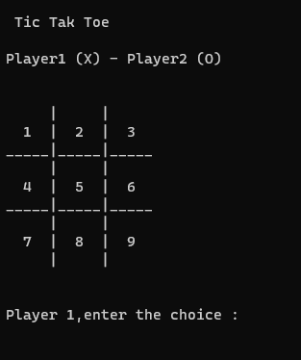
CONSOLE
There are mainly three case scenario's as described below.
Player 1 won the Match
Player 2 won the Match
No result Match Draw

Slide 11
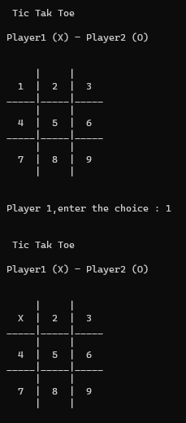
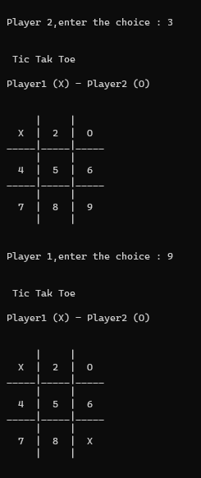
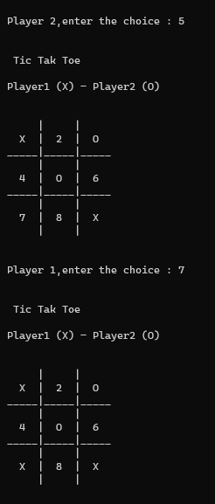
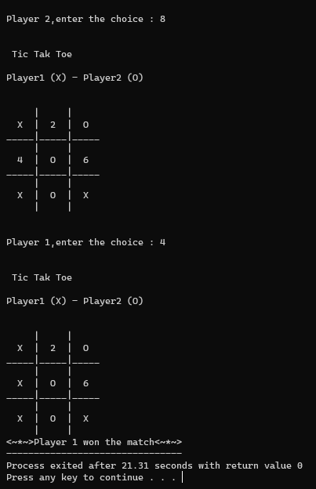
Case-1: Player 1 won the match

Slide 12
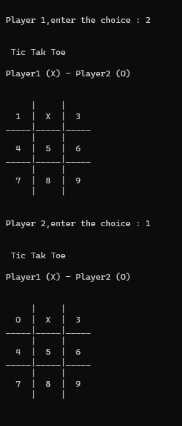
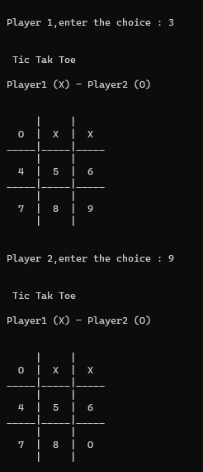
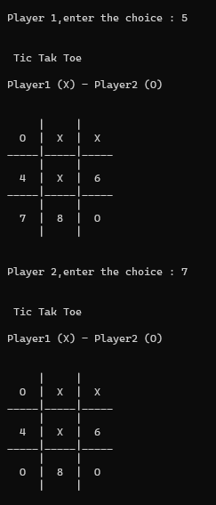
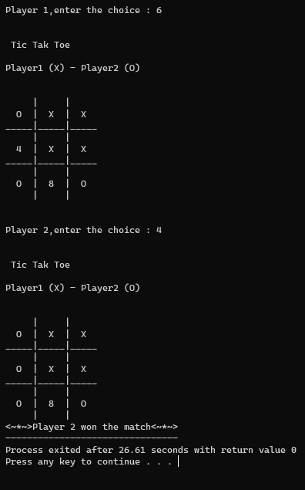
Case-2: Player 2 won the match

Slide 13
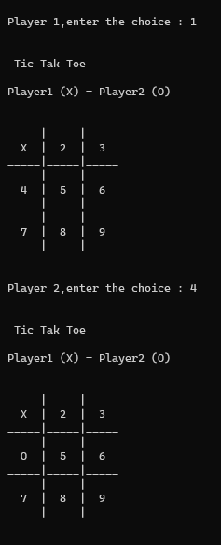
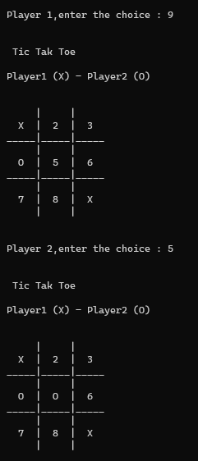
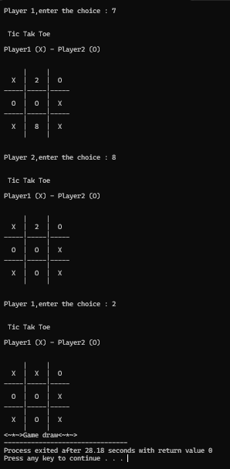
Case-3: match draw

Slide 14
CONCLUSION
In the game of Tic Tac Toe, the conclusion arises when a player successfully places three of their markers in a row, either horizontally, vertically, or diagonally. This achievement signifies their victory in the game.
Conversely, if all spaces on the board are filled, and no player achieves a winning alignment, the game concludes in a draw or a tie, indicating that neither player has emerged as the winner.
The simplicity of Tic Tac Toe belies its strategic depth, making it a classic and timeless game enjoyed by players of all ages.

Slide 15
FUTURE SCOPE OF THE PROJECT
Educational Applications:
Develop educational modules within the game to teach basic strategy, logic, or even programming concepts.
Collaborate with educational institutions to incorporate the game into learning environments.
Multiplayer and Online Connectivity:
Implement multiplayer functionality to allow users to play against each other in real-time.
Integrate online connectivity features, enabling players to compete with friends or random opponents over the internet.

Slide 16


